Slide 1
Micro-Credit Defaulter Model Project
Submitted By-
Arumoy Saha

Slide 2
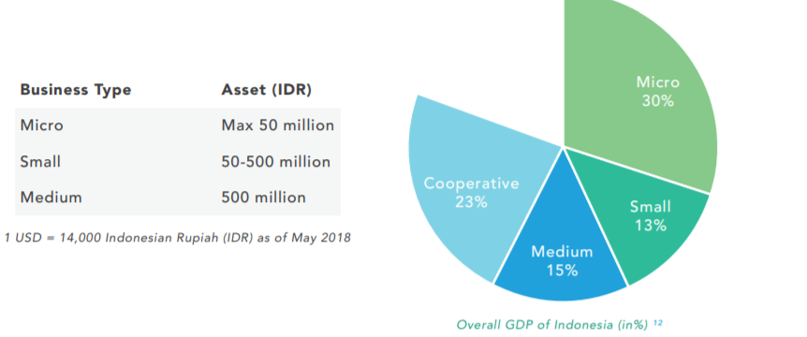
Financial ecosystem in Indonesia for MSME

Slide 3
Financial ecosystem in Indonesia for MSME
Around 95 Percent of the total workforce in Indonesia is employed MSME out of total workforces available for employment.
While 90 percent overall businesses enterprise are MSME, contributes to larger part in economic development of the country.
MSME account for approximately 60 percent of overall GDP for Indonesia.

Slide 4
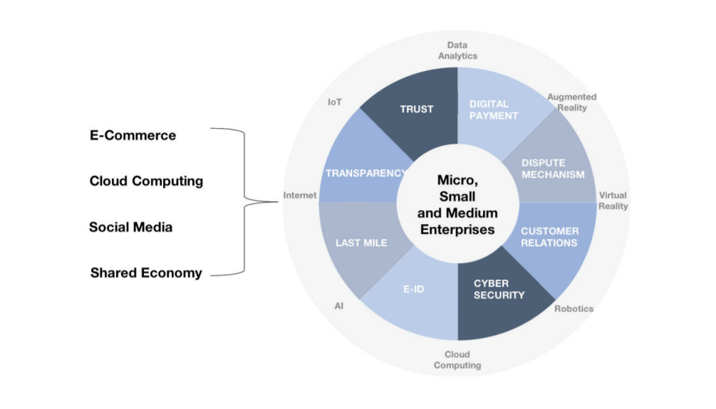
Drivers for economic growth in MSME sector

Slide 5
Drivers for economic growth in MSME sector
60 percent of the overall MSME enterprises are present online, therefore accessibility to these solutions providers are easy for customers.
For an ecommerce service providers transactions through the digital space and connect buyers, sellers and other partiers into a single platform makes the MSME business more transparent at all levels.
With the advancement of the technologies like cloud computing enables the enterprise to leverage the right resources in real time to provide the solutions using digital platform, makes the MSME business more reliable, affordable.
As the community are connected via social media to a large extent interaction, content sharing, customer happiness are measured real time with the presence of digital medium helps the MSME to build the right strategy for business expansion & growth.
In Indonesia shared economy revolutionize the micro markets and goes beyond shared economy helps reducing cost of using a product or services while the customers connected through digital ecosystem.

Slide 6
Objective of the project
Micro credit service provider tied up with MFI for giving loan for mobile balances to be paid back in 5 days.
Objective is to find out whether the customer will be a defaulter given as “label-0” or a non-defaulter termed as “label-1”.
Objective is also to improve the customer selection process for the micro credit providers by helping them with the right predicted model with the dataset provided.
From this dataset the objective also to find out customer behaviors and understand the loan repay period, that can help building the right strategy for micro credit providers for further investment.

Slide 7
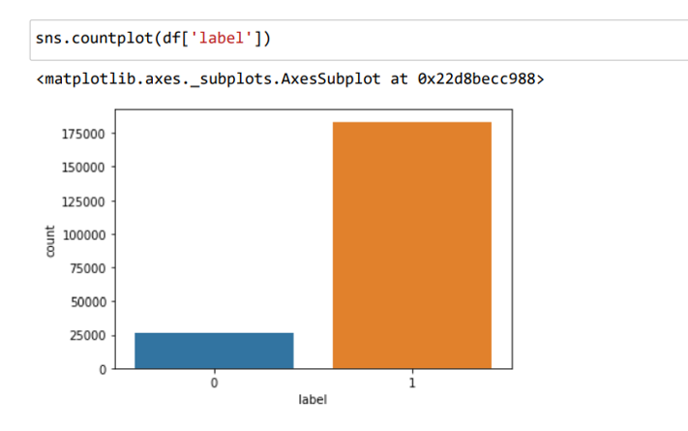
Exploratory data analysis process
From this, count plot we understand the number of defaulter and non-defaulter in mobile balance loan. In this project, Label ‘1’ defines that the loan has been payed i.e. Non- defaulter, while, Label ‘0’ indicates that the loan has not been payed i.e. defaulter.

Slide 8
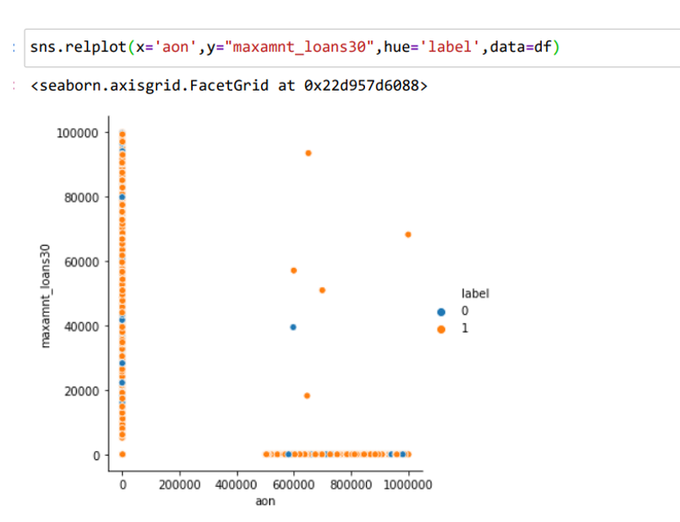
Exploratory data analysis process
From the above relplot we have visualize the data for the features maximum loan taken by user in the last 30 days and whether the customer will be a defaulter/non defaulter with the age of cellular network taken into account.

Slide 9
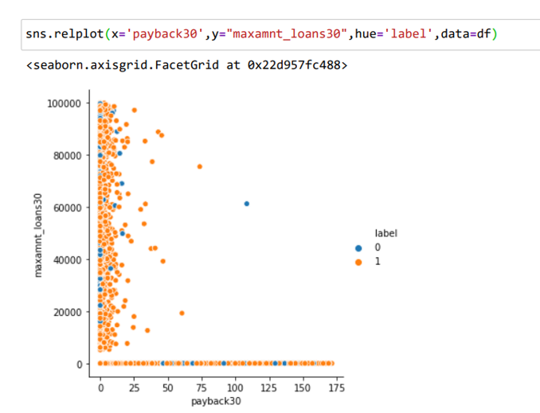
Exploratory data analysis process
From the above relational plot we have visualize the maximum loan taken in 30 days by the customer with the average payback period over the last 30 days also we visualize whether the customer is a defaulter/non defaulter in this credit period.

Slide 10
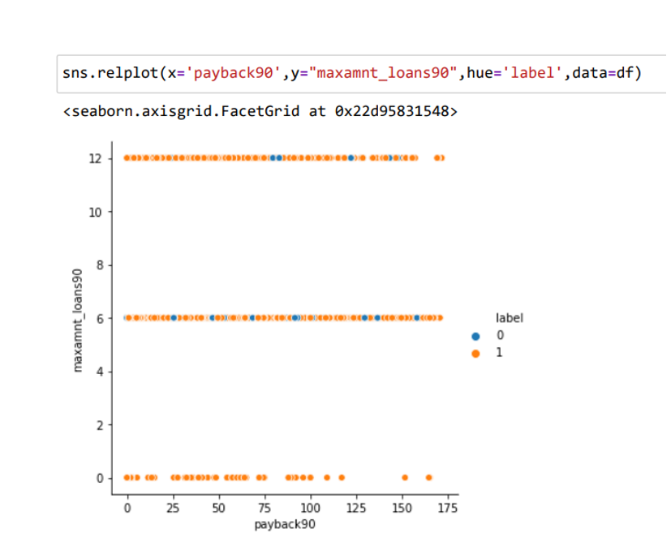
Exploratory data analysis process
From the above relational plot, we have visualized the maximum loan taken in 90 days by the user with the average payback period over the last 90 days also we understand whether the user is a defaulter/non defaulter in this particular credit period.

Slide 11
Model building process
In this dataset, I assume label is the target variable. In this case, Label ‘1’ indicates that the loan has been payed i.e. Non- defaulter, while, Label ‘0’ indicates that the loan has not been payed i.e. defaulter.
I have come across outliers in some features which handled as per the understanding. Keep in mind that data is expensive and cannot afford to lose more than 7-8% of the data.
proposed a random forest classifier model to predict the probability of defaulter and improvement in selecting the customers for micro credit process.

Slide 12
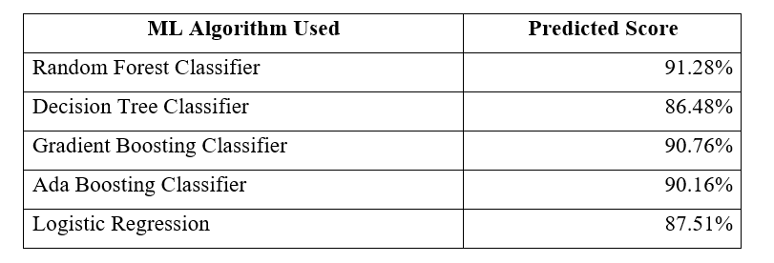
Model Dashboard
To predict the result of this dataset above are machine learning algorithm used for evaluations.
Out of all the machine learning models used I have selected Random forest Classifier model for further evaluation of this dataset.

Slide 13
CONCLUSIONS
I have used various classification methods and out of all algorithm, Random Forest Classifier yields the best results.
Since the credit period was very short so we got know the customer behaviour can be used for further research in others micro credit aspects as well.
We have applied Label Encoder method to change the categorical variables into normalize the input features and make it in machine standard format.
This micro credit process can be used rural development as well as for economic development of the country.

